Slide 1
BOGIA COCONUT SYDROME (BCS) STATUS REPORT
October 2018
Kokonas Indastri Koporesen

Slide 2
Location of Papua New Guinea

Slide 3
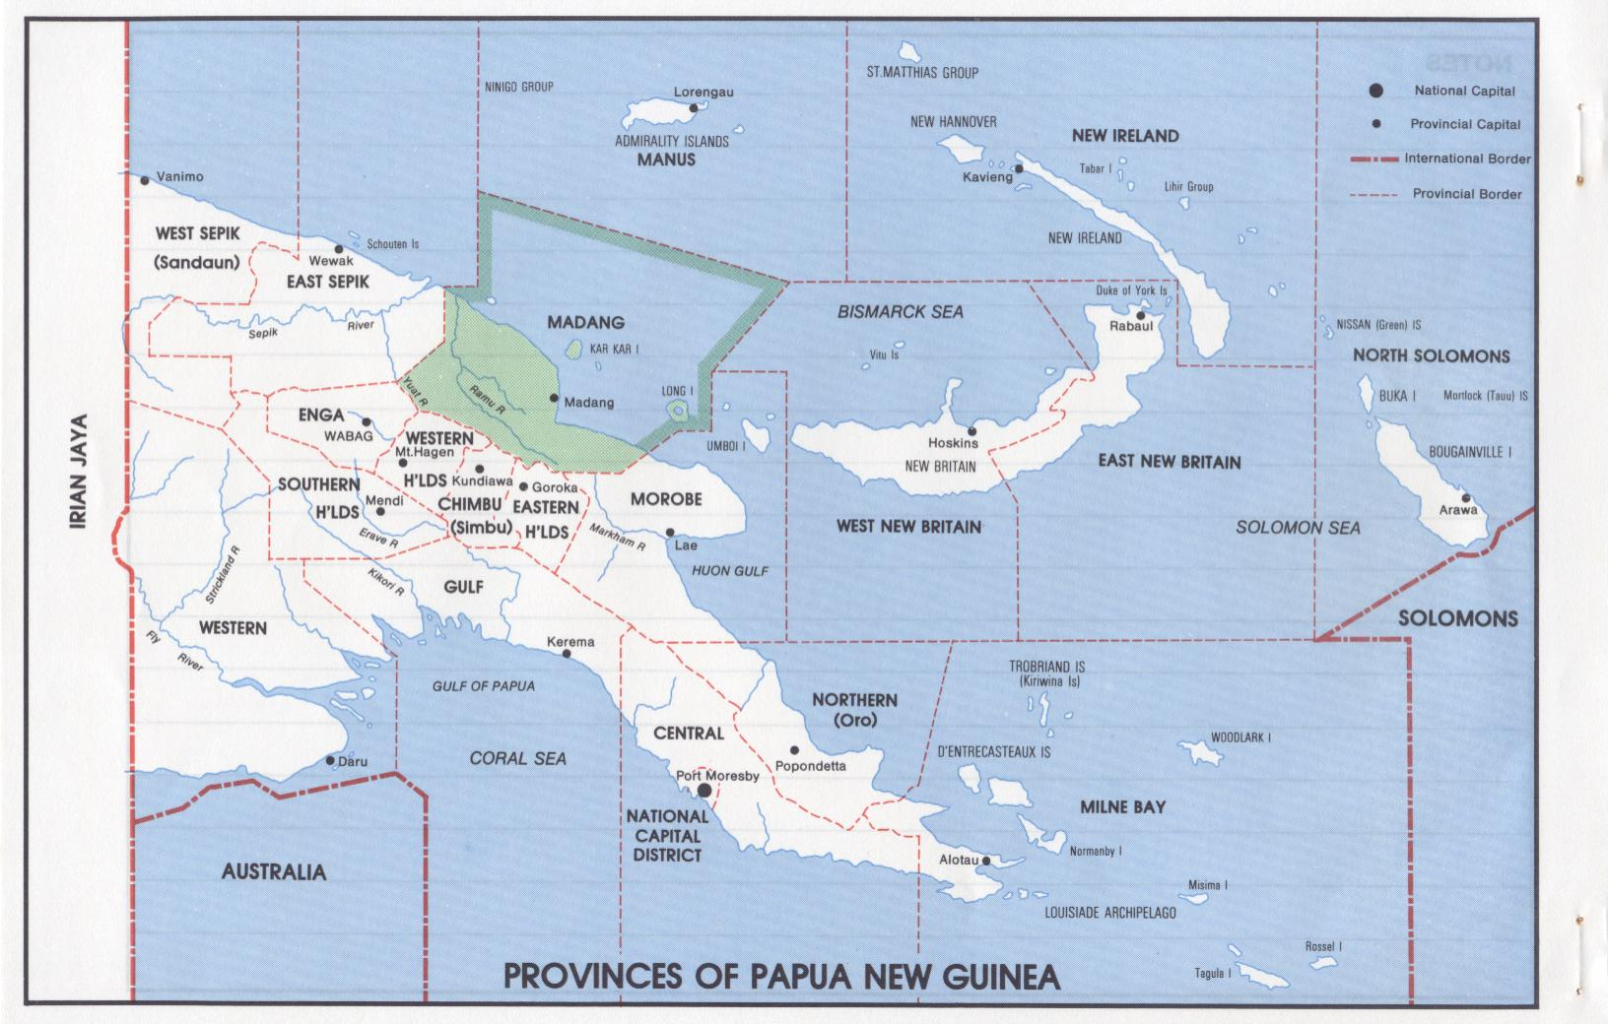
Provinces of PNG

Slide 4
BCS in Madang & Oil Palm Estates
BOGIA, SUMKAR & MADANG DISTRICTS IN MADANG PROVINCE
Oil Palm
Poliamba, NI
Oil Palm
Kimbe, WNB
Oil Palm
Ramu, Madang
Oil Palm
Higaturu, Oro
Oil Palm,
Milne Bay

Slide 5
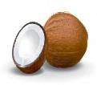
BCS – Phytoplasma & Aetiology
Causal organism:
Identified as Candidatus phytoplasma.
Strongly linked to a new pathogen known as banana wilt associated phytoplasma (BWAP) also found in bananas also in Madang, Province.
Aetiology of BCS:
4 groups: Caribbean, Ghana-Mozambique, Tanzania & PNG
4 Subgroups : Dom Rep., Mexico and Cuba, Mozambique & Ghana
PNG (BCS) is a new group.
(Dollet M. et al PowerPoint Presentation at 18th COGENT SC Meeting 2017, Nadi, Fiji)

Slide 6
BCS – Vector & Risks
Vector:
From all the insects studied , 7 groups of insects collected in Madang (Furan/Omuru) mainly plant sap suckers were found to carry the BCS organism.
Zophiuma pupillata appears to be the main transmitting vector.
Potential risks:
Coconuts, betel nuts and banana crops are at immediate risk.
Potentially oil palm and other food crops are also at risk.
ICG-SP very vulnerable
BCS front is less than 5 km radius

Slide 7
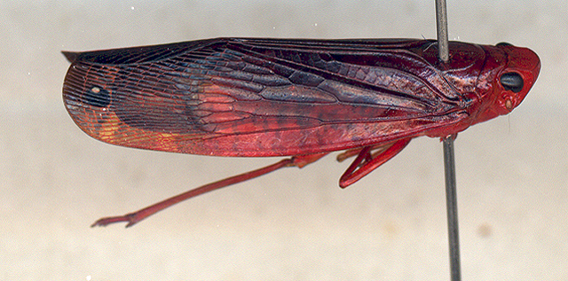
Vectors of Bogia Coconut Syndrome (cont’d)
Vector:
Zophiuma pupillata appears to be the many transmitting vector.

Slide 8
NORTH Spread of BCS SOUTH
BCS – Spread in Madang
Source: Dr. Michel Dollet (CIRAD)

Slide 9
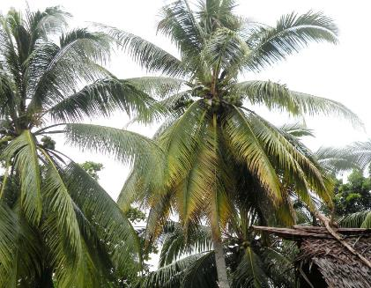
Bogia Coconut Syndrome Symptoms
Stage 1 Symptoms
Plate 1: Palm (front) showing early yellowing of older fronds.
Plate 2: Palm (right) showing yellowing of older fronds and start to droop.

Slide 10
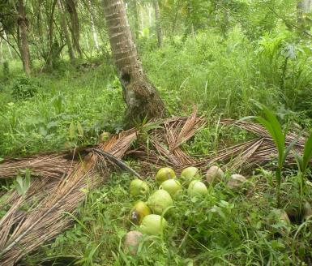
Bogia Coconut Syndrome Symptoms (cont’d)
Stage 2 Symptoms
Plate 3: Palm with 50% of mature fronds have senesced and dried up. Green nuts will soon fall.
Plate 4: All green nuts fall off irrespective of age in affected palms .

Slide 11
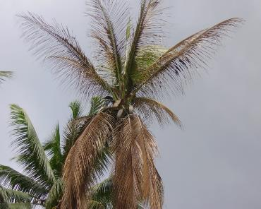
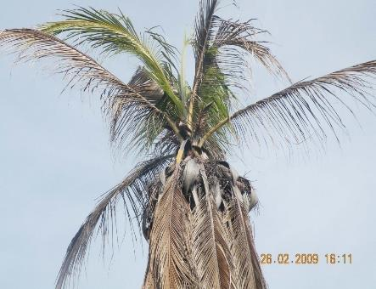
Bogia Coconut Syndrome Symptoms (cont’d)
Stage 3 Symptoms
Plate 5: Palm with reduced crown canopy, dried fronds and empty fruit bunches still attached.
Plate 6: Palm with most of its older fronds and fruit bunches dried up except for two youngest fronds still green.

Slide 12
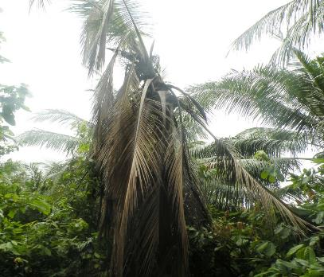
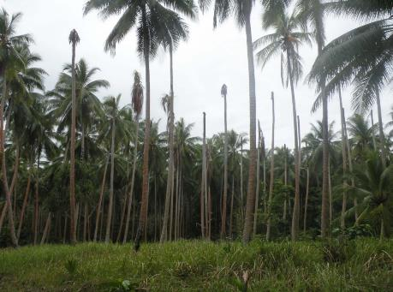
Bogia Coconut Syndrome Symptoms (cont’d)
Stage 4 Symptoms
Plate 7: A palm with dead fronds and the rotting spear is still attached to the trunk.
Plate 8: A patch of dead palms without crowns (fallen off) surrounded by surviving coconut palms.

Slide 13
Symptoms on Banana

Slide 14
Symptoms on Betel nut

Slide 15
Current & Way Forward
Madang
Containment of BCS in Madang / Tapo check point
BCS awareness and surveillance continue
ACIAR Vector studies continue until June 2019
Characterization of accessions completed at ICG-SP
Refurbishment of pollen lab, embryo culture lab and laminar flow in 2019
Procurement of pollination bags and other materials and equipment in 2019
Refresher training of pollinators in 2019
BCS Diagnostic Assay Kit Technology – UQ
UQ team to train KIK officers on the use of the technology
KIK to commence BCS samples from accessions in current ICG-SP in Madang for assessing the presesnce or abscenc of BCS from the parent palms.

Slide 16
ACKNOWLEDGEMENTS
Government of PNG – substantial financial support since 2016 for BCS & ICG-SP Relocation program [Total funds to date K 10.5 m (USD 2.73 m)]
CGIAR / CROP TRUST / BIODIVERSITY / COGENT – initial financial support
ACIAR – BCS Vector Study
CIRAD – Technical Assistance in prospecting techniques
APCC – Regional networking

Slide 17
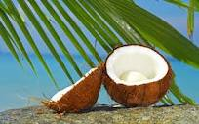
Thank you

